Slide 1
19AD784
IMAGE ANALYSIS AND COMPUTER VISION
Dr E Emerson Nithiyaraj
AP/ECE

Slide 2
UNIT II
IMAGE ENHANCEMENT
Dr E Emerson Nithiyaraj
AP/ECE

Slide 3
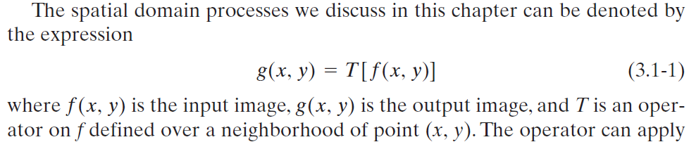
Gray level transformations
Spatial domain techniques operate directly on the pixels of an image as opposed, for example, to the frequency domain in which operations are performed on the Fourier transform of an image, rather than on the image itself.

Slide 4
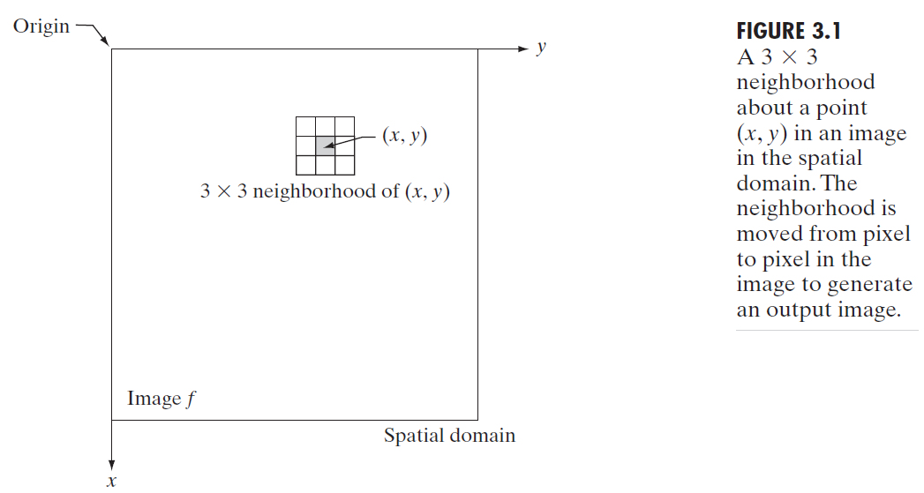
Gray level transformations
The procedure just described is called spatial filtering, in which the neighborhood, along with a predefined operation, is called a spatial filter (also referred to as a spatial mask, kernel, template, or window).
The type of operation performed in the neighborhood determines the nature of the filtering process.

Slide 5
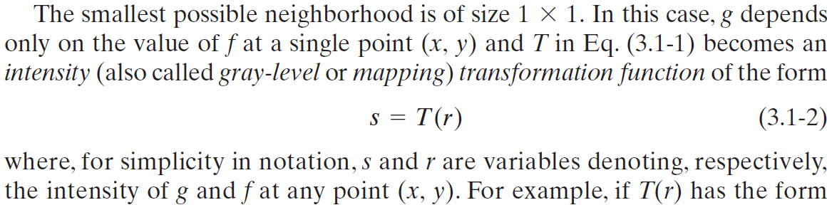
Gray level transformations

Slide 6
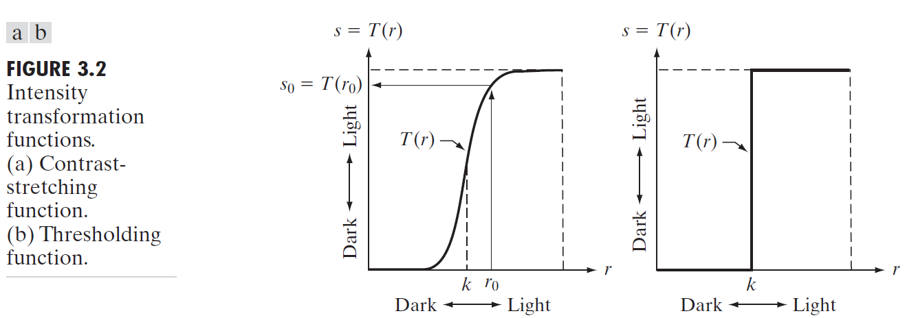
Gray level transformations
Approaches whose results depend only on the intensity at a point sometimes are called point processing techniques, as opposed to the neighborhood processing techniques.

Slide 7

Basic Intensity / Gray level transformations
The values of pixels, before and after processing, will be denoted by r and s, respectively.
These values are related by an expression of the form
where T is a transformation that maps a pixel value r into a pixel value s.

Slide 8
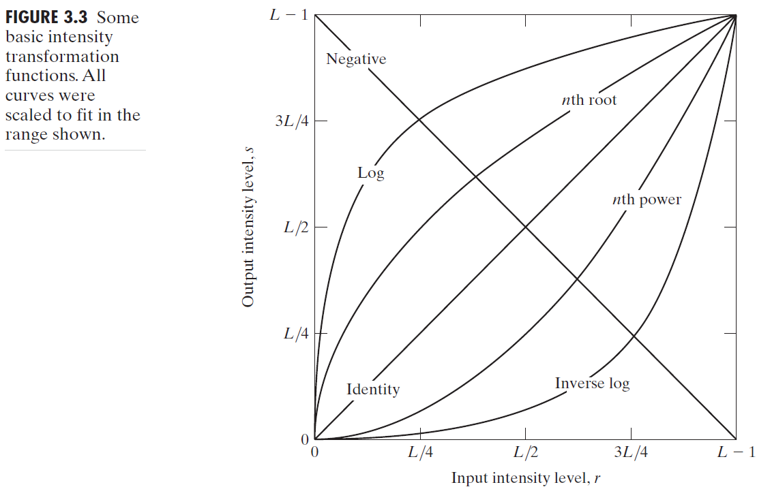
Basic Intensity / Gray level transformations

Slide 9
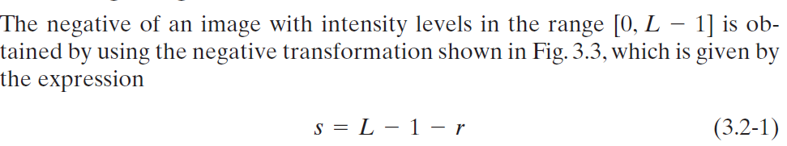
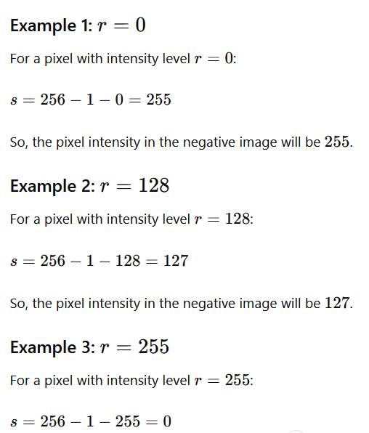
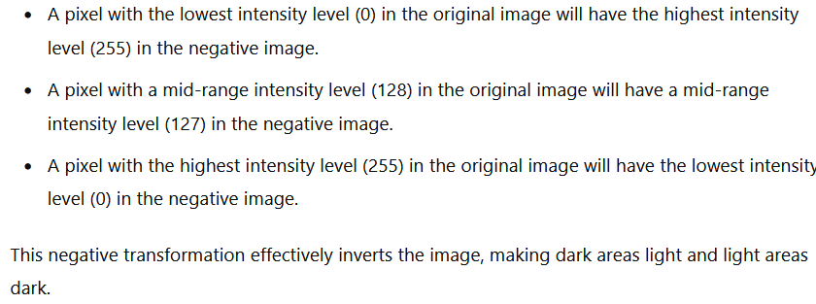
Gray level transformations - Image Negatives

Slide 10
Gray level transformations - Image Negatives

Slide 11
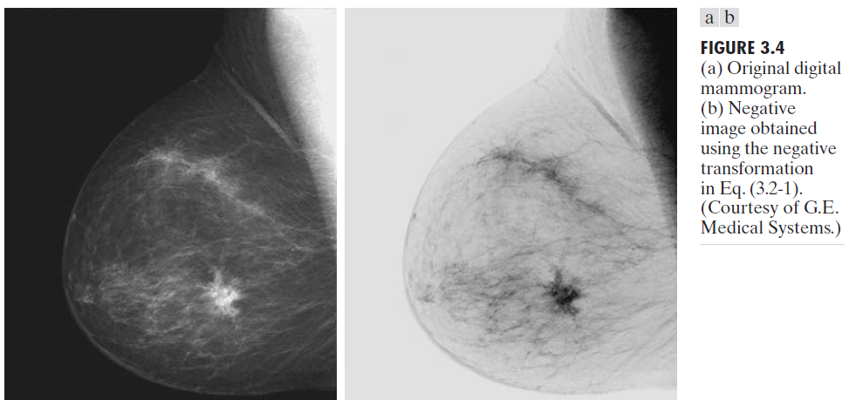
This type of processing is particularly suited for enhancing white or gray detail embedded in dark regions of an image, especially when the black areas are dominant in size.

Slide 12
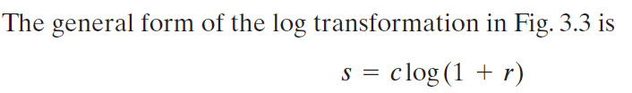
Gray level transformations - Log Transformations
The shape of the log curve shows that this transformation maps a narrow range of low intensity values in the input into a wider range of output levels. The opposite is true of higher values of input levels.
Log transformations make dark pixels lighter and bright pixels less bright. c is a constant that adjusts the brightness.
We use a transformation of this type to expand the values of dark pixels in an image while compressing the higher-level values. The opposite is true of the inverse log transformation.

Slide 13
Gray level transformations - Log Transformations
The log function has the important characteristic that it compresses the dynamic range of images with large variations in pixel values.
Dynamic range of an image is the difference between the darkest and brightest parts of the image.
If an image has both very dark and very bright areas, it has a large dynamic range.

Slide 14
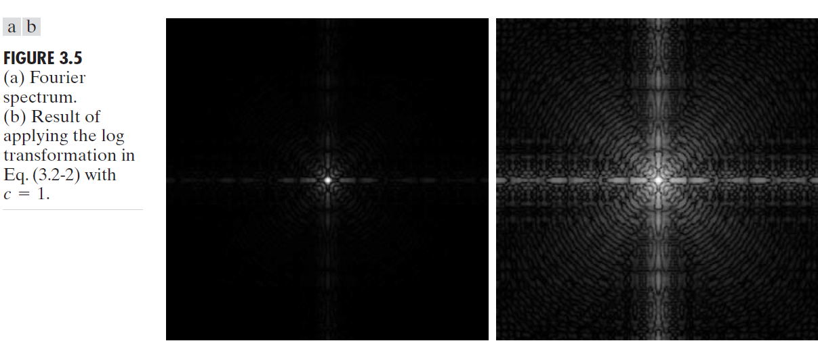
Gray level transformations - Log Transformations
The wealth of detail visible in this image as compared to an unmodified display of the spectrum is evident from these pictures. Most of the Fourier spectra seen in image processing publications have been scaled in just this manner.

Slide 15
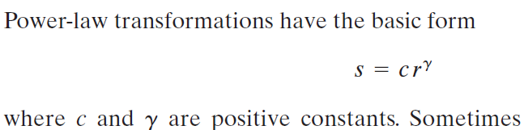
Gray level transformations - Power-Law (Gamma) Transformations
Power-law transformations adjust the brightness based on a power factor γ.
c is a constant and γ controls how the brightness is changed.

Slide 16
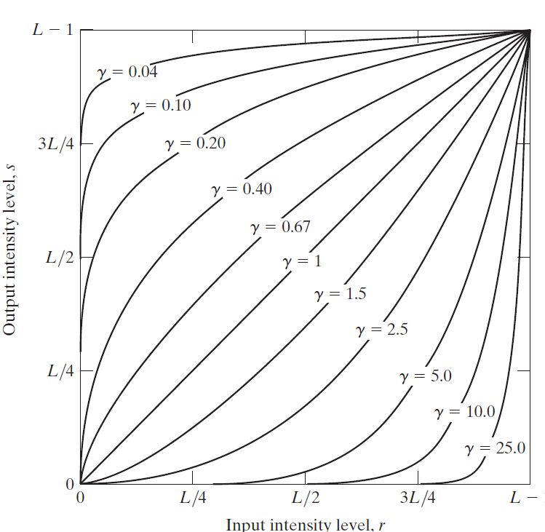
When 0<γ<1, the transformation maps a narrow range of dark input values into a wider range of output values, making dark areas brighter.
When γ>1, the transformation compresses the range of dark input values and maps a wider range of bright input values into a narrower range of output values, making bright areas darker.
A variety of devices used for image capture, printing, and display respond according to a power law. By convention, the exponent in the power-law equation is referred to as gamma.
The process used to correct these power-law response phenomena is called gamma correction.

Slide 17
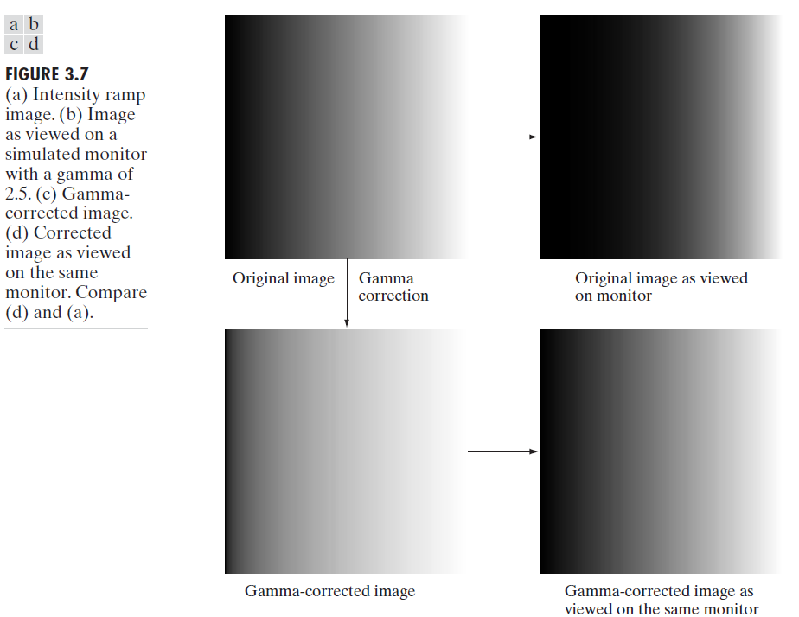

Slide 18
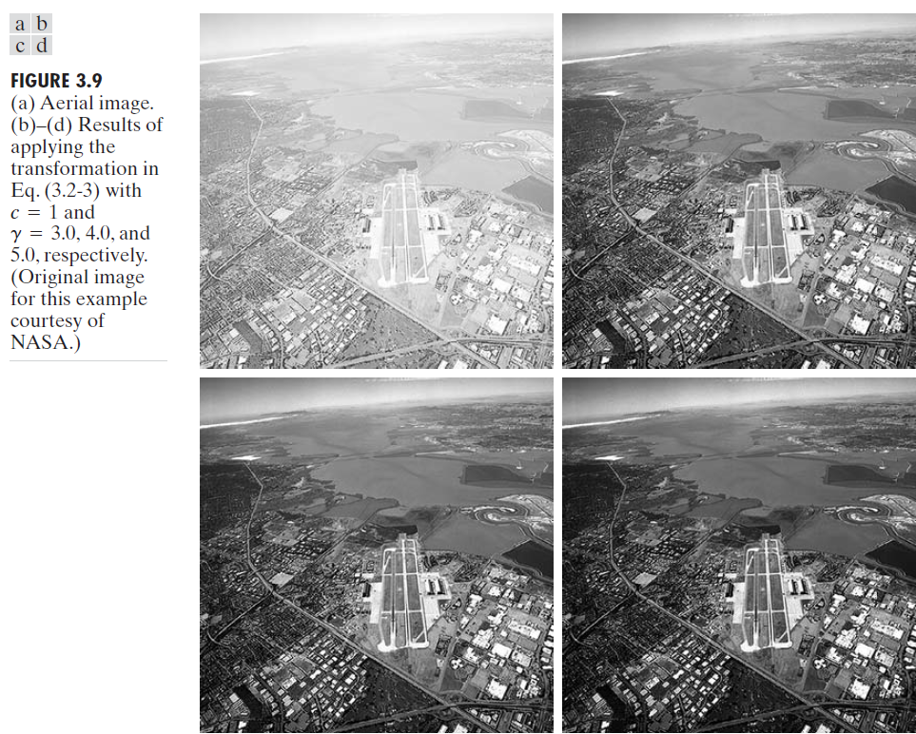
In addition to gamma correction, power-law transformations are useful for general-purpose contrast manipulation. (Fig. 3.8)

Slide 19
Piecewise-Linear Transformation Functions
A piecewise transformation changes pixel values based on different linear functions applied to different ranges of input values.
A pointwise transformation changes each pixel value in an image based on a function that operates only on that pixel's value.
Contrast stretching is a process that expands the range of intensity levels in an image so that it spans the full intensity range of the recording medium or display device.

Slide 20
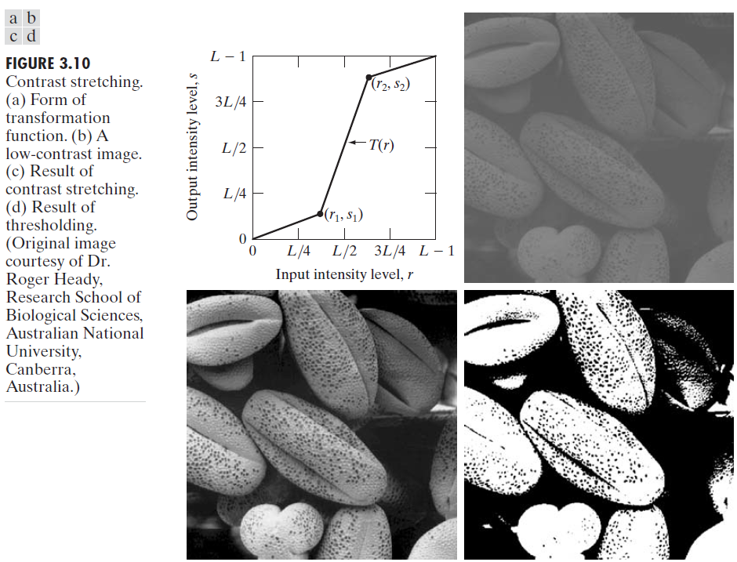
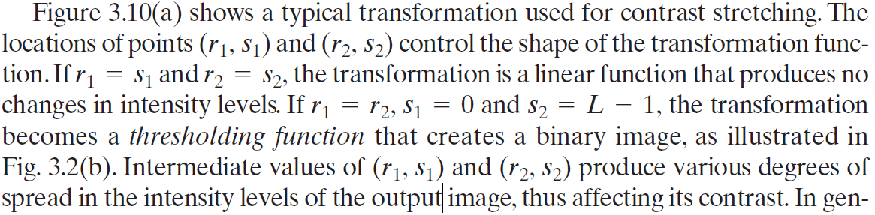

Slide 21





Slide 22
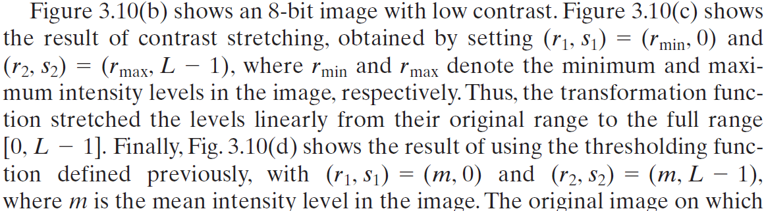

Slide 23
Intensity-level slicing
Intensity level slicing highlights a specific range of intensities and maps all other intensities to a constant value.
Applications include enhancing features such as masses of water in satellite imagery and enhancing flaws in X-ray images.

Slide 24
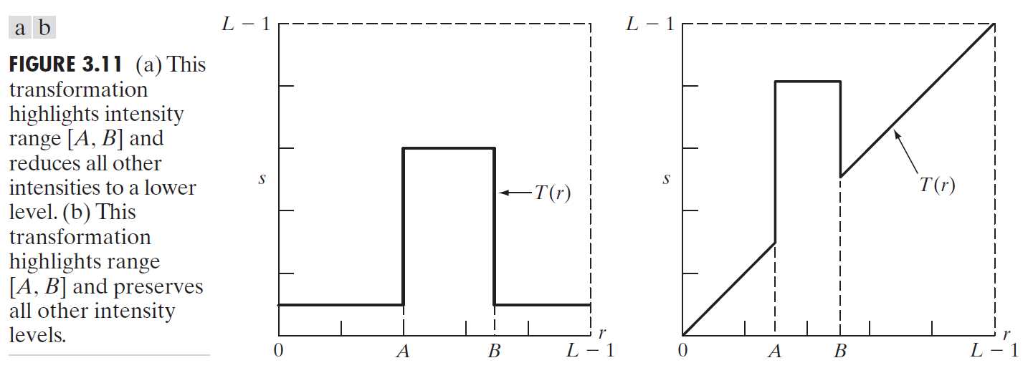
One approach is to display in one value (say, white) all the values in the range of interest and in another (say, black) all other intensities.
Brightens (or darkens) the desired range of intensities but leaves all other intensity levels in the image unchanged.

Slide 25
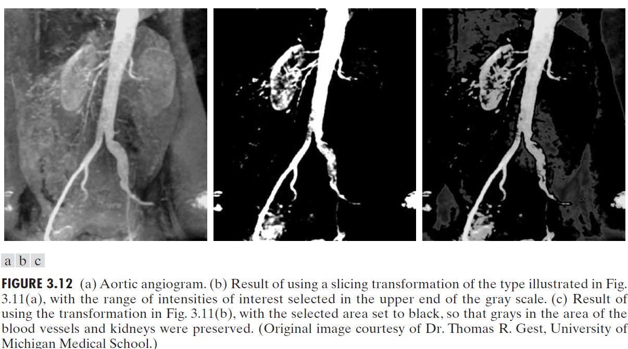

Slide 26
Bit-plane slicing involves highlighting specific bits in the binary representation of the pixel intensities. This technique can reveal details not visible in the higher or lower bits.
Instead of highlighting intensity-level ranges, we could highlight the contribution made to total image appearance by specific bits.

Slide 27
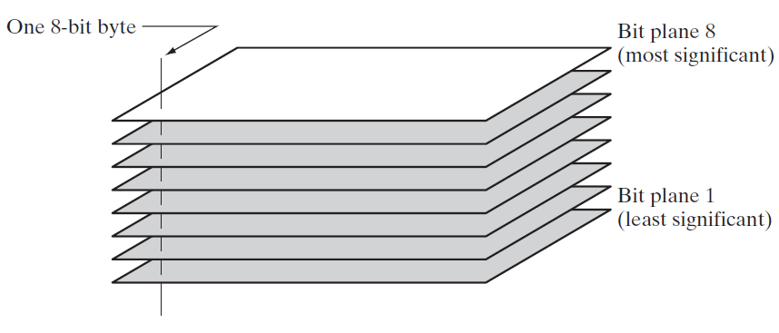

Slide 28
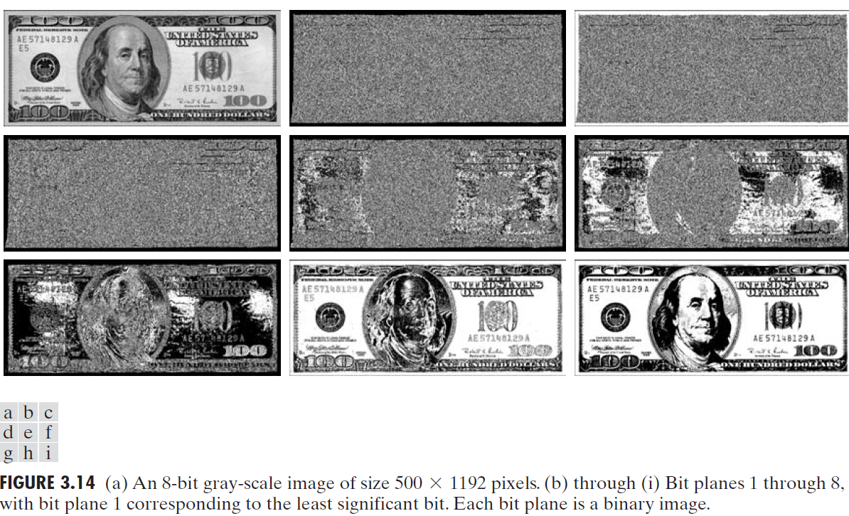

Slide 29
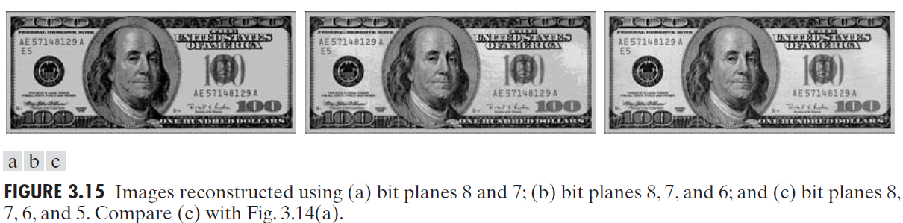
Storing the four highest-order bit planes would allow us to reconstruct the original image in acceptable detail. Storing these four planes instead of the original image requires 50% less storage (ignoring memory architecture issues).

Slide 30
